Slide 1
Bridging Science and Policy in India’s State Action Plans on Climate Change
Case study of Uttarakhand
Jennifer Steeves, Acclimatise
8 March 2017
IITM, Pune
Notes:
Research and Implementation Experience with State Action Plan Development Activities

Slide 2
Today’s presentation
Current context of state climate plans in India
Case study Uttarakhand (video)
Agenda for Climate Action – snapshot of agriculture sector
Next steps for Uttarakhand
Key insights from VRA process
Notes:
One of the conference’s objectives: Engage and share experience in the application of downscaled climate information to inform decision making, including discussions on the State Action Plan Development
Will give an overview of how a VRA process, using downscaled data, can feed into state climate and development policy and planning, and ultimately, deliver resilience building actions on the ground. Won’t go into detail on VRA process – this will be covered in a subsequent presentation by Dr Sandhya Rao

Slide 3
State Climate Plans in India: current context
All states and UTs have drafted State Action Plans on Climate Change (SAPCCs)
Currently focussing on
    Vulnerability Risk Assessments (VRAs)
    Prioritisation through implementation plans
    Mainstreaming in priority sectors
    Pipeline of projects for funding
    Funding though existing schemes
Next Steps
    Find linkages with India’s Nationally Determined Contributions and ongoing National Adaptation Plan
Notes:
All states and Union territories in India have a state action plan on Climate change (2009 directive from the Central Government under the National Action Plan on Climate Change)
States at different levels of operationalisation:
Odisha plan first prepared: rewritten completed in April
Delhi Plan not yet in the public domain
Pondicherry Plan: full implementation by World Bank
MoEF asked for Prioritisation through Implementation plans
VRAs: West Bengal (GIZ), MP (GIZ), Jharkhand (UNDP), Chhattisgarh (UNDP), Uttarakhand (CDKN), as well as sector specific VRAs – eg. Water
Sikkim: some portion operationalised using the MGNREGA funds - initiated work on recharging lakes and streams as well as reviving dried-up lakes on hilltops using MGNREGA funds. This is an extension of on-going work on springs as well as other pilot projects in the state.

Slide 4
Video - Climate Change & Uttarakhand: The Road to Resilience
Notes:
Let’s take a look at how a VRA was integrated into the state climate planning process in Uttarakhand

Slide 5
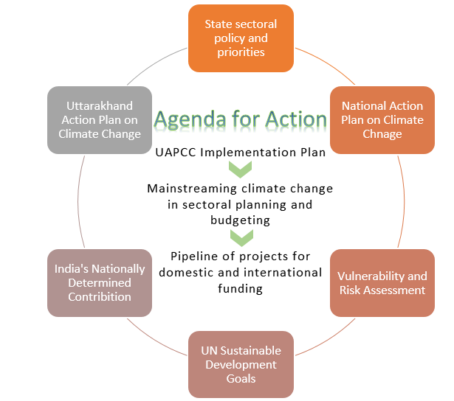
Mapping climate action in Uttarakhand
State Centre for Climate Change
Up to 1% sectoral budget allocation for CC
(upcoming) Climate Change Knowledge Portal
Notes:
This figure shows a picture of the state of climate action/institutions in Uttarakhand at different scales
UAPCC endorsed by the National Steering Committee on Climate Change, GoI, in 2014
VRA focussed on 5 sectors, including preliminary PRAs for villages in identified hotspots (innovative approach to marry top-down with bottom-up, given that downscaling still produces results that are too coarse for block-level planning)
“Agenda for Climate Action” assess policy implications of the VRA
Uttarakhand State Centre for Climate Change (climate institution in place)
Climate Change Knowledge Portal
The Chief Secretary has agreed that departments can allocate up to 1% of the State’s department budget for climate related activities identified in UAPCC
There is enough knowledge to make better decisions
How can the state (Climate Action Group, Working groups, & State Climate Change Centre) translate the evidence of the VRA into action?
Need to look at practical considerations of what government depts and other organisations can do in the short and medium term - focusing on actionable steps in policy selection, implementation, mainstreaming, finance and further research
As well as overcoming institutional bottlenecks

Slide 6
Agenda for Climate Action:
Bridging science & policy
Step 1
VRA review
Step 2
Identification of climate impact areas
Step 3
Policy review
Review
Step 4
Participatory Rural Appraisal (PRA) review
Step 6
Step 5
Development of Agenda for Climate Action
Identification of co-benefits
Step 7
Policy Validation
India’s NDC
Relevant missions under the NAPCC
State sector policies
UAPCC
Uttarakhand Development Report
Notes:
VRA results were analysed to identify broad climate impact areas in the sectors of focus. This was accompanied by a policy review and a review of a community-level assessment

Slide 7
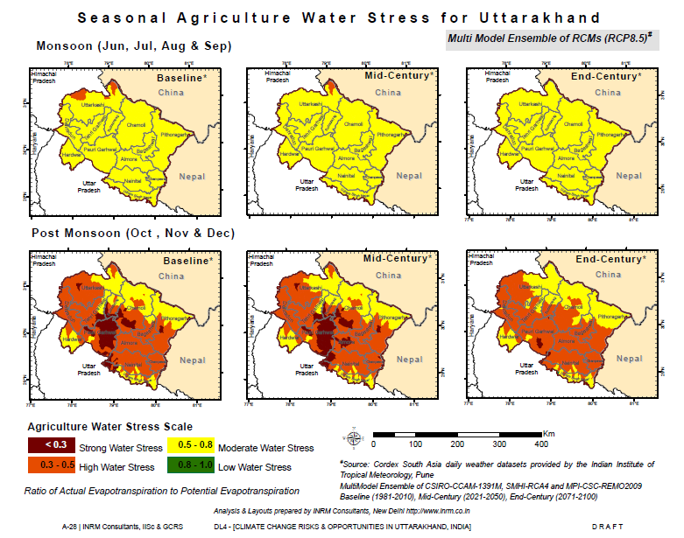
Agriculture
Climate Impact Areas
Increased water stress
Increased risk of flooding
Changes in crop yields
Notes:
Science
Let’s take a quick look at the VRA results in one sector and how they were used to derive policy guidance
I will not go into depth about the VRA process and results, as Dr Rao will do that in her presentation.

Slide 8
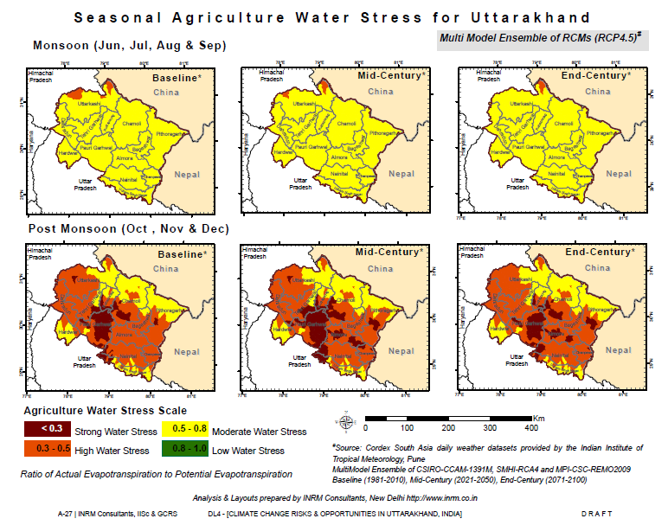
Agriculture
Notes:
Science

Slide 9
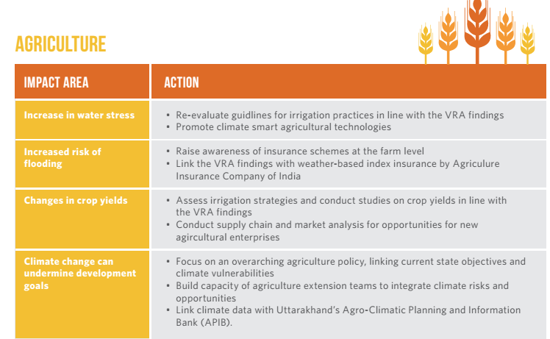
Agenda for Climate Action
Notes:
Policy guidance
Vulnerability: increased T, evapotranspiration losses lead to water stress, which makes plants more vulnerable to pests and diseases and implies increased (ground or surface water) requirement for irrigation.
In light of projected increased water stress, re-evaluate guidelines for irrigation practices especially district irrigation plans (in the vulnerable districts identified as a priority) incorporating VRA evidence, eg. increase or decrease in water yield, in which districts/blocks, and at what time of year.
The districts of Almora, Champawat, Garhwal (Pauri), Tehri Garhwal are likely to experience higher agriculture water stress -> direct focus here.
changes in temperature and rainfall have the potential to affect crop water demand and productivity, and thus yields, both negatively and positively. We have seen that an increase in wheat yield (15-20%) and rice yield (2-5%) is expected. However, a decline in production of rice and wheat is likely in the districts of Uttarkashi, Rudraprayag, Chamoli and Garhwal (Pauri) under both scenarios. Changes in climate may lead to better growing conditions in certain districts. This also means there may be opportunities to increase production and productivity of different types of crops; for example, higher temperatures allow seasonally longer plant growth for crops in cool and mountainous areas that remain at low temperatures for most of the time. In contrast, in already warm areas, climate change can cause reduction in productivity. Shifts in crop types has already been observed at ground level, where villages are taking advantage of the opportunity to grow fruit crops such as mango and banana to adapt to temperature increases [Note that higher value crops like mango, also have deteriorate very quickly and access to markets is very important.]
Irrigation strategies should be assessed alongside further studies on crop yields in the face of climate change to evaluate whether further investment in irrigation in certain areas is warranted (eg. if increase in drought is projected) or if investment in drought-resistant crops will provide a better return.
AEZ projects: lychees, flowers, basmati rice, medicinal and aromatic plants

Slide 10
Water
Climate Impact Areas
Seasonal changes in water availability
Increased risk of flooding
Potential improved stream flow
Implications for management of dam infrastructure

Slide 11

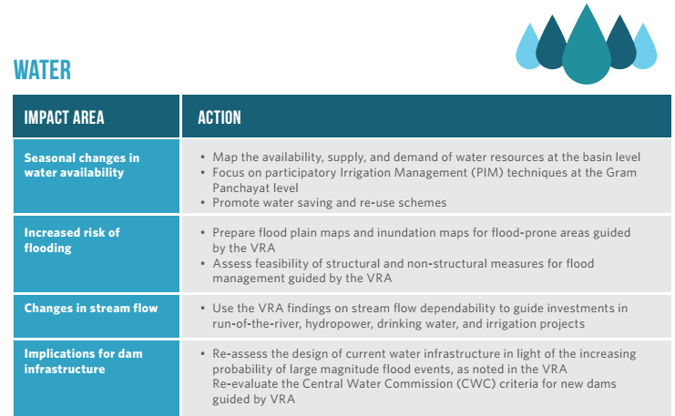
Agenda for Action
Notes:
Recommendations to account for increasing probability of large magnitude flood events occurring in future include a) re-assess the design of current major water infrastructure (such as the Tehri and Kalagarh dams) and b) re-evaluate criteria for new water infrastructure projects in view of likely future climate change
Use VRA findings on stream flow dependability when assessing and planning projects such as run-of-the-river hydropower, drinking water and irrigation, to take advantage of when and where river flows are likely to be sustained year-round.

Slide 12
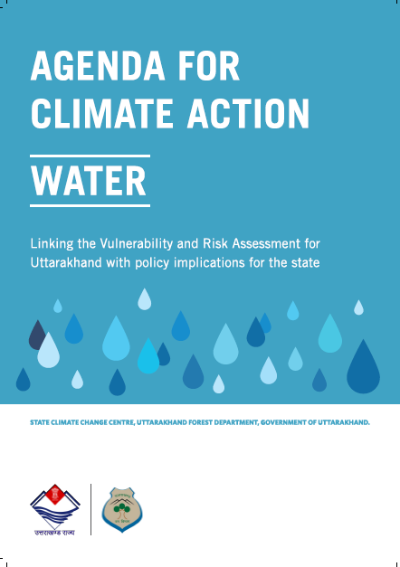
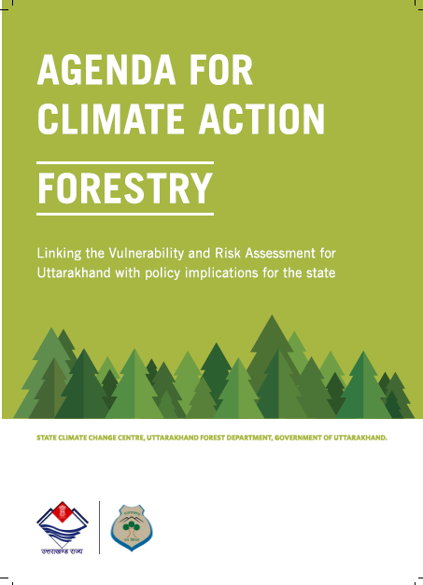
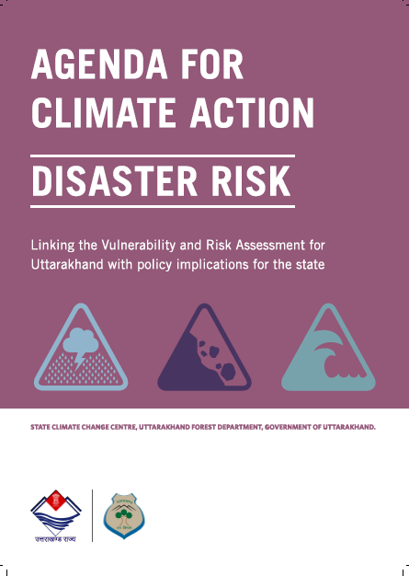
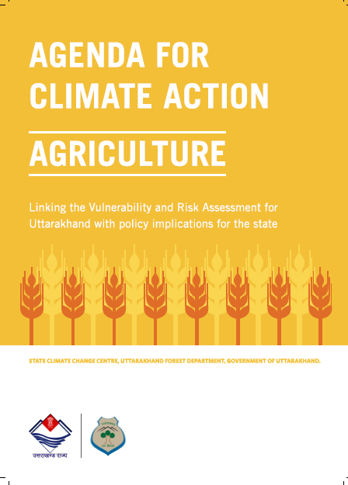
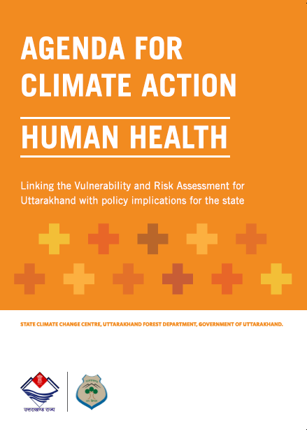
Agenda for Climate Action

Slide 13

Agenda for Climate Action: Next steps for all sectors
On-ground research to validate VRA results
Targeted impact assessments
Review and update policy objectives, in line with climate evidence
Further research in the areas of VRA limitations
Use adaptive management, options flexible and robust against a range of future climate outcomes
Notes:
Agenda for Action is a tool for mainstreaming

Slide 14
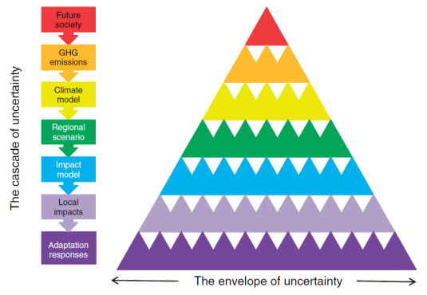
Decision-making in the face of uncertainty
Focus on robustness to today’s and tomorrow's potential climate – not necessarily the ‘optimal’ solution
(Wilby and Dessai, 2010)
Notes:
Also need to consider principles of decision making under uncertainty. The VRA does not give us 1 possible future – there are multiple possible futures dependent on a number of factors
A cascade of uncertainty proceeds from different socio-economic and demographic pathways, their translation into concentrations of atmospheric greenhouse gas (GHG) concentrations, expressed climate outcomes in global and regional models, translation into local impacts on human and natural systems, and implied adaptation responses. The increasing number of triangles at each level symbolise the growing number of permutations and hence expanding envelope of uncertainty. For example, even relatively reliable hydrological models can yield very different results depending on the methods (and observed data) used for calibration (Wilby and Desai, 2010).
Focus on strategies that perform well over a wide range of conditions now and in the future. Low regret – yield benefits even in the absence of CC
RCD might inform the options appraisal by establishing plausible upper and lower bounds to climate change sensitivity testing.
Adaptive management of climate risks involves careful monitoring of the environment and systematic appraisal of the performance of measures (Figure 3). The resulting adaptation pathway will be shaped by the evolving scientific evidence and societal attitudes to risk. (eg. Thames Estuary 2100)
Allowing adaptation options appraisal to take centre stage rather than CC scenarios.
Important to get the message across that uncertainty is not a bad thing, and that we make decisions every day based on less than certain information.

Slide 15
Key insights
VRA results provide an evidence base to guide policy and planning, determine where to invest limited resources, support funding requests
VRA results require significant interpretation to be useful to decision-makers (Agenda for Climate Action)
Next step is prioritization of specific actions for implementation given limited resources -> co-benefits approach
On-ground adaptation actions cannot be directly derived from VRA results, at their current level of specificity
Further research is required to validate model-based results, overcome VRA limitations
Notes:
1 – Providing an evidence base for more informed and robust decision making. Process in U’khand: SAPCC -> VRA -> policy. VRA ideally should have guided the plan, (Central guidance on developing SAPCCs stresses the importance of a VRA) but instead it was identified as a need in the plan, which was then picked up by the state/ CDKN. Research (CPR study) shows that very rarely in state climate planning were final recommendations informed by climate science and research findings (Karnataka being only exception). Why? This knowledge is difficult to access, or is only easily accessible at a larger scale which is inadequate for state level planning (eg. Indian Network of Climate Change Assessment 2010 study).
2 – Agenda for Climate Action was an intensive exercise, required a lot of back and forth with scientists, inputs from stakeholders in state.
3- Prioritization of actions using a co-benefits approach. MCDA is one tool to do this, using multiple criteria to assess the performance of a single policy against multiple objectives. Requires stakeholder participation -> transparent and defensible. VRA results can be one input into this process. BUT VRA results require further detail/specificity to be useful in this type of exercise – the more specific the better. Criteria to prioritise might be: Existing vulnerability, availability of funding, robustness against multiple scenarios, cost benefit ratio, alignment with central/state schemes etc.
4 - VRA is a top-down exercise. Need to further validate model-based results to make robust decisions under uncertainty. Much of the AfA guidance pertains to pointing out areas of further research guided by the VRA. Also Need to further validate VRA through an in-depth PRA and also establish a clear baseline for current vulnerability at the community-level. Focus research in areas where the VRA has limitations such as event based floods- cloud-bursts, forest fires, temperature of water bodies to assess mosquito breeding patterns etc.
Results are not specific enough to guide implementation -> they give us broad impact areas, which, when married with state development policies/current priorities, give us an indication of where investment should be directed now and in future. Arriving at specific actions needs to be done by sectoral departments themselves, in a participatory manner (eg. MCDA method, which requires further level of detail)
UPACC Implementation value is currently pegged at 8832 Cr Rs: look at what constitutes existing development activities and for additional funds ask the GoI or other sources

Slide 16
International policy implications
All states’ VRAs do not follow a consistent framework, which presents a challenge in aggregating data and providing a standardized picture of vulnerability across the country
  This creates a challenge for implementing India’s Nationally Determined Contribution (NDC) – how to measure vulnerability reduction?
Notes:
MOEFCC has been discussing a national vulnerability index

Slide 17
Questions for reflection
How can we bridge the gap between VRA results and implementation of climate action on the ground?
Is the evidence base produced by a VRA robust enough to support proposals for climate finance?

Slide 18
Thank you!

Slide 19
Backup slides

Slide 20
Sectors addressed by the VRA
  Agriculture
  Water
  Health
  Forestry
  Disaster
Infrastructure
Tourism
Animal Husbandry
Urban Development
Industries

Slide 21
State climate Plans: funding so far
No. | National Adaptation Fund, GoI | State | Outlay (Cr Rs)
1 | Climate Resilient Livestock Production System | Punjab | 17.40
2 | Management of run-off in the river basin in Nuapada | Odisha | 20.00
3 | Sustainable Livelihoods of Agriculture-Dependent Rural Communities in Drought Prone District of HP | Himachal Pradesh | 20.00
4 | Model Carbon Positive Eco-Village in Phayeng Of Manipur | Manipur | 10.00
5 | Management and rehabilitation of coastal habitats and biodiversity in Gulf of Mannar | Tamil Nadu | 24.74
6 | Promotion of Integrated Farming System of Kaipad and Pokkali in coastal wetlands | Kerala | 25.00
7 | Sustainable Agriculture Development through Expansion, Enhancement and Modelling | Mizoram | 10.38
8 | Climate Adaptation Strategies in Wetlands along Mahanadi River Catchment areas in Chhattisgarh | Chhattisgarh | 21.47
9 | Climate Resilient Sustainable Agriculture in Rain-Fed Farming (Kandi) Areas of J&K | Jammu and Kashmir | 22.52
10 | Spring-shed development works for rejuvenation of springs in the water stressed areas of Meghalaya | Meghalaya | 22.92
11 | Resilient Agricultural Households in Mahbubnagar District, Telangana | Telangana | 24.00
12 | Integrated surface Water Management through Rejuvenation of 20 tanks and 32 village ponds | Puducherry | 16.76
No. | Adaptation Fund, UNFCCC | State | Outlay (USD Mn)
1 | Conservation and Management of Coastal Resources for Sea Level Rise | Andhra Pradesh | 0.69
2 | Increasing Resilience of Small and Marginal Farmers in Purulia and Bankura Districts | West Bengal | 2.51
3 | Building Adaptive Capacities of Small Inland Fishermen Community | Madhya Pradesh, | 1.79
4 | Climate Proofing of Watershed Development Projects | Tamil Nadu and Rajasthan | 1.344
5 | Climate smart actions in north western Himalayan region for sustainable livelihoods of agriculture-dependent hill communities | Uttarakhand | 0.969
6 | Livelihoods and Ecological Security in the Kanha-Pench Corridor (PCN approved) | Madhya Pradesh | 2.50
Notes:
BIAF: 6.5 cr rs
The project aims to improve the adaptive capacity of rural small and marginal farmers including hill women in North Western Himalayan region by introducing a combination of Climate Smart Farming Technologies along with required social engineering and capacity building processes
Evidence Base was the ICIMOD, (IFAD) Intl Fund for Aagri development perception study, 2010 as the evidence base
22 projects in all: covering 18 states

Slide 22
State Climate Plans in India: funding so far
Notes:
All states and Union territories in India have a state action plan on Climate change
States at different levels of operationalisation:
Odisha plan first prepared: rewritten completed in April
Delhi Plan not yet in the public domain
Pondicherry Plan: full implementation by World Bank
MoEF asked for Prioritisation through Implemtation plans
VRAs: West Bengal (GIZ), MP (GIZ), Jharkhand (UNDP), Chhattisgarh (UNDP), Uttarakhand (CDKN)
Sikkim: some portion operationalised using the MGNREGA funds

Slide 23
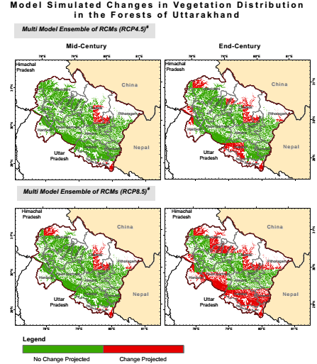
Forests
Climate Impact Areas
Changes and shifts in forest types
Uncertainty in biomass availability
Increase in forest fires
Loss of floral biodiversity
RCP 8.5
RCP 4.5
Model Simulated Changes in Vegetation Distribution in the Forests of Uttarakhand

Slide 24
Agenda for Action: Forestry
Link VRA findings with specific policies governing NTFPs
Strengthen existing systems to improve productivity, collection and market access for NTFPs
Research in shifts in specific forest types and tree species
Research on forest fires

Slide 25
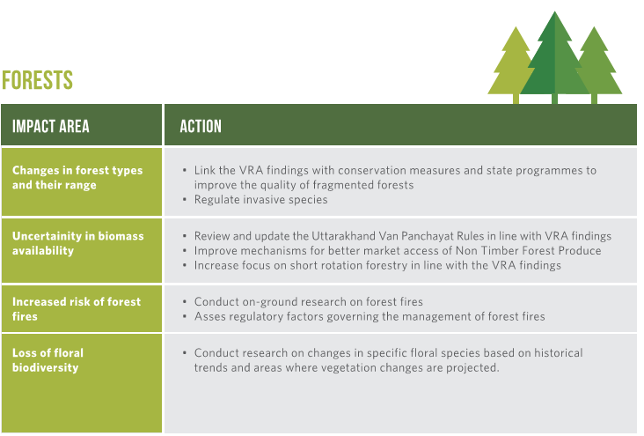
Agenda for Action

Slide 26
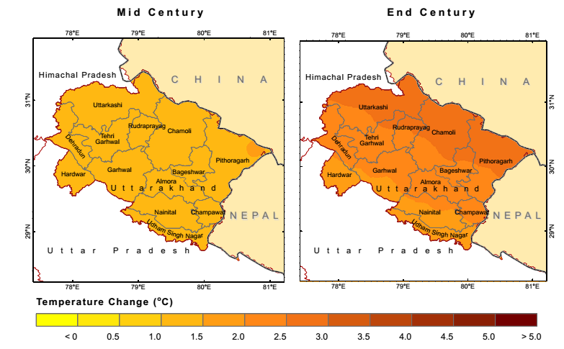
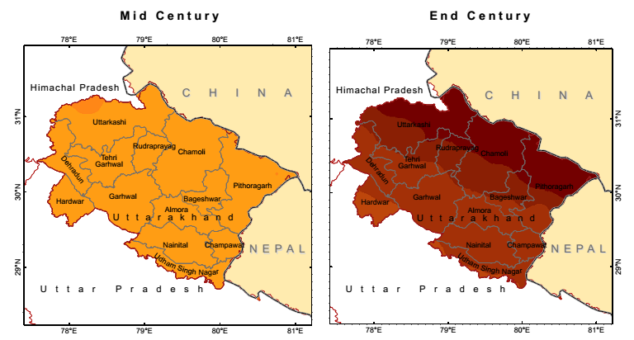
Projected Future Changes in Annual Max Temperature for Mid Century and End Century with respect to Baseline (1981 - 2010)
Health
Climate Impact Areas
Increased heat stress
Increase in malaria and other vector borne diseases
Increased floods and landslides
RCP 4.5
RCP 8.5

Slide 27
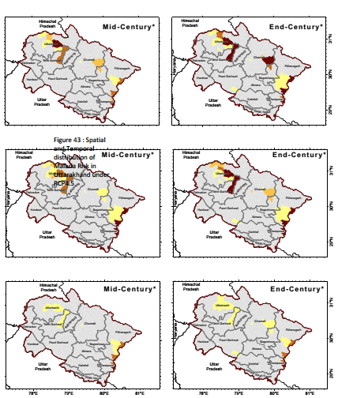
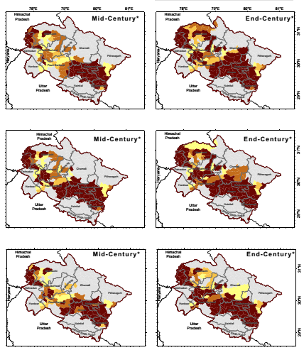

Monthly Variations in the Geographic Distribution of Adult Mosquito Occurrence
Health
RCP 4.5
RCP 8.5

Slide 28
Agenda for Action: Health
Factor heat stress as a health impact in current policies ~Heat Action Plan
Review and strengthen programmes to tackle vector borne diseases: Focus beyond the current plain districts
Undertake district level analysis of disaster prone regions
Focus on cloud-bursts, assessment of water bodies and water surface temperatures

Slide 29
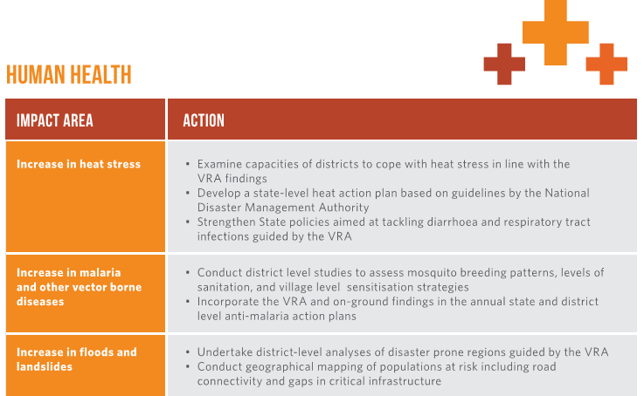
Agenda for Action

Slide 30
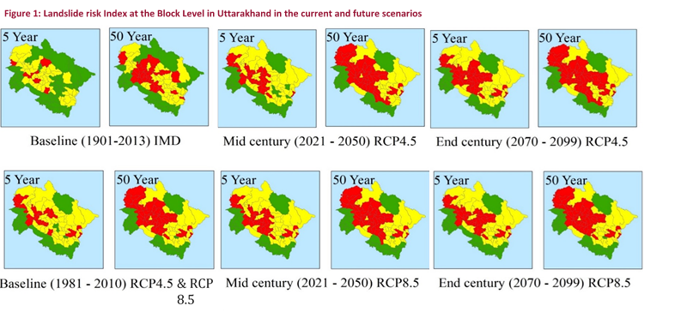
Disaster Risk
Climate Impact Areas
Worsening soil erosion and landslides
Floods and landslides increase vulnerability of local communities
Climate risks not linked to current disaster management policies
Risk of snow melt and GLOFs resulting in flash floods

Slide 31
Disaster Risk
Worsening soil erosion and landslides
Incorporate landslide management techniques in all infrastructure development, with emphasis on road construction Measures such as no habitation on quaternary deposits, little to no use of explosives in the hills, slope stabilization measures aligned with all slope modification works) Forest conservation and avoided deforestation measures in disaster prone regions linked to VRA findings

Slide 32
Disaster Risk
Climate risk not linked to current disaster management policies
Review and update of state, districts and village disaster management plans linked to risk analysis report Re-examine critical infrastructure inventory (such as police resources, hospitals, Primary and community health care centres, helipads etc.) as detailed in the SNDP for vulnerable districts and blocks based on the risk analysis report

Slide 33
Disaster Risk
Snow melt and GLOFs resulting in flash floods
Further research on model limitations Temperature changes which can lead to snowmelt and Glacial Lake Outburst Floods (GLOFs) further exacerbating floods and landslides

Slide 34
Disaster Risk
Disaster risk can worsen current development objectives
Mainstreaming DM & climate resilience in development programmes; ensuring programmes are sanctioned after conducting comprehensive climate and disaster risk assessments Ensuring each selected project or initiative has factored sufficient funds to deal with extreme events Comprehensive risk analysis as well as safety audits for all new and existing infrastructure based on risk analysis report and the VRA. Ensure incorporation of disaster resistant features in all new constructions as stipulated by national building codes & other Bureau of Indian Standards codes

Slide 35
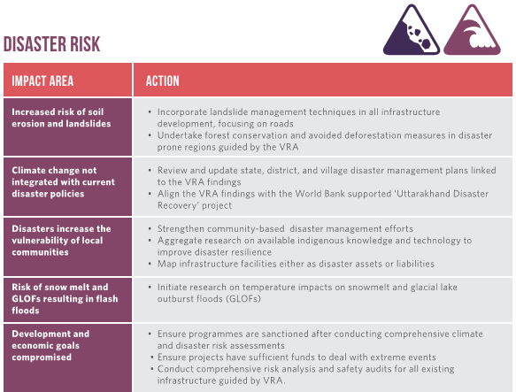
Agenda for Action

